Slide 1



Coding Club of CIT Kokrajhar
“Everybody should learn to program a computer, because it teaches you how to think”
~ Steve Jobs

Slide 2
Contents:-
Faculty Mentors
Core Team
Objectives of the club
Focused Area
For whom?
Benefits of Coding
Upcoming events
How to join the club?
Contact details

Slide 3

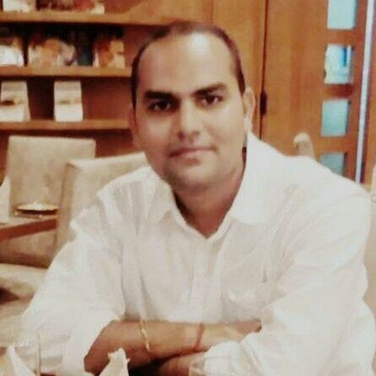
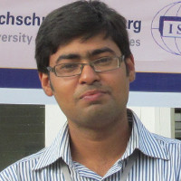
Faculty Mentor:-
Dr. Pranav Kr. Singh
Dean Alumni & External Affairs, CITK
Assistant Professor Department of CSE
Faculty mentor, Coding Club CITK
Dr. Amitava Nag
Associate Professor Department of CSE
Faculty mentor, Coding Club CITK
Dr. Pankaj Pratap Singh
Assistant Professor Department of CSE
Faculty mentor, Coding Club CITK

Slide 4
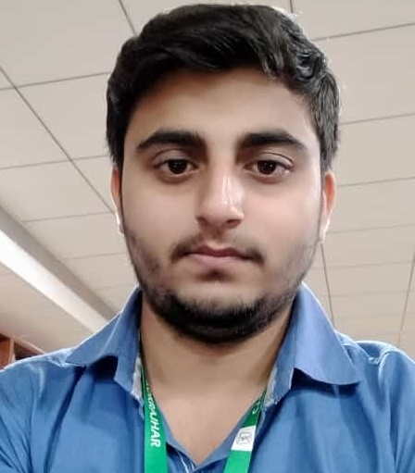
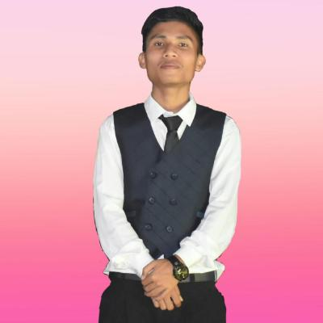
Core Team:-
Amarjeet Kumar Singh Karmabir Brahma (Convenor) (Cheif-coordinator)

Slide 5
Other Core Members:-
Devanshu (CP Lead)
Innocent Dengkhw Mochahari
Souptik Dutta
Darshan Hazarika
Amrit Kumar Tiwari
Himanshu Pegu

Slide 6
Objectives of Coding Club :-
Bring up the coding culture in our Institute
To discuss programming concepts using various languages such as C/C++, Java, Python, etc.
To compete in various coding contests.
To get start with competitive programming
Organize various competitions
Collaborate with other Institutions
Mutual helping platform for beginners

Slide 7

Focused Areas:-
Getting Started with C/C++/Java/Python
Programming Languages
Competitive programming
Low level languages
Scripting languages
Data Structures
Algorithms
Software Development

Slide 8
For Whom:-
Who wants to enter into the field of Coding
Who wants to improve Problem Solving skills
Who wants to enter into Competitive Programming
All having interest in Software Development

Slide 9





Why to join our club?
You will get environment
You will learn different programming languages
Build connections
To get into a product based company (FAANG Companies)

Slide 10



Benefits of Coding:-
Promotes logical thinking.
Develops persistence.
Improve one’s communication skills.
Improve one’s structural thinking.
Improves one’s math skills.
Helps in improving problem-solving skills.

Slide 11

Real life applications:-
Web Devlopment
App Devlopment
Cryptography
Cyber Security
Artificial Intelligence
IOT, and many more..

Slide 12
Upcoming events:-
An Online Talk by Alumini
Coding Competition in the Techracy
Quiz competittion in the Techracy
Bootcamp on C++/Java
Workshop on Basic of Data Structure
Session by Faculty mentor

Slide 13
Announcements:-
Coder of the month. (Top performer of the month)
Coder of the year. (Top performer of the year)
Best Branch Representative.
Note:- All the above top performers will be given Certificates and Coding Club goodies.

Slide 14
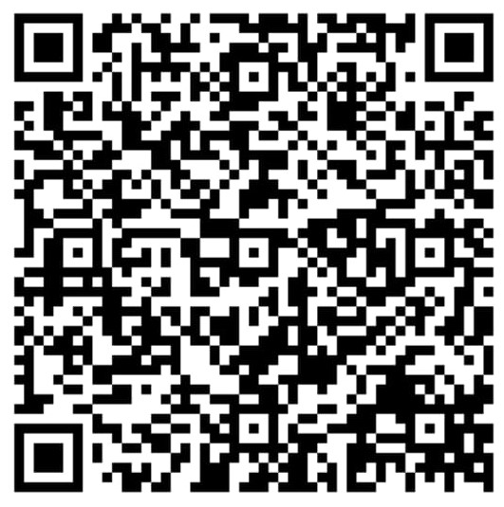
How to join?
Fill the google form online.
₹100 joining fee.
Note:- All the members have to be active in each and every events organized by Coding Club CITK.

Slide 15
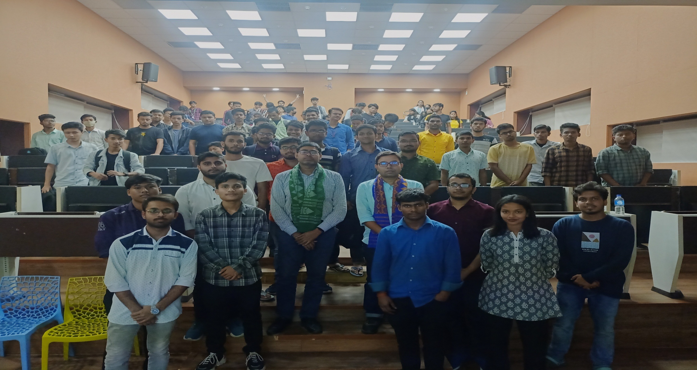
Moments from the last Orientation program of the club

Slide 16
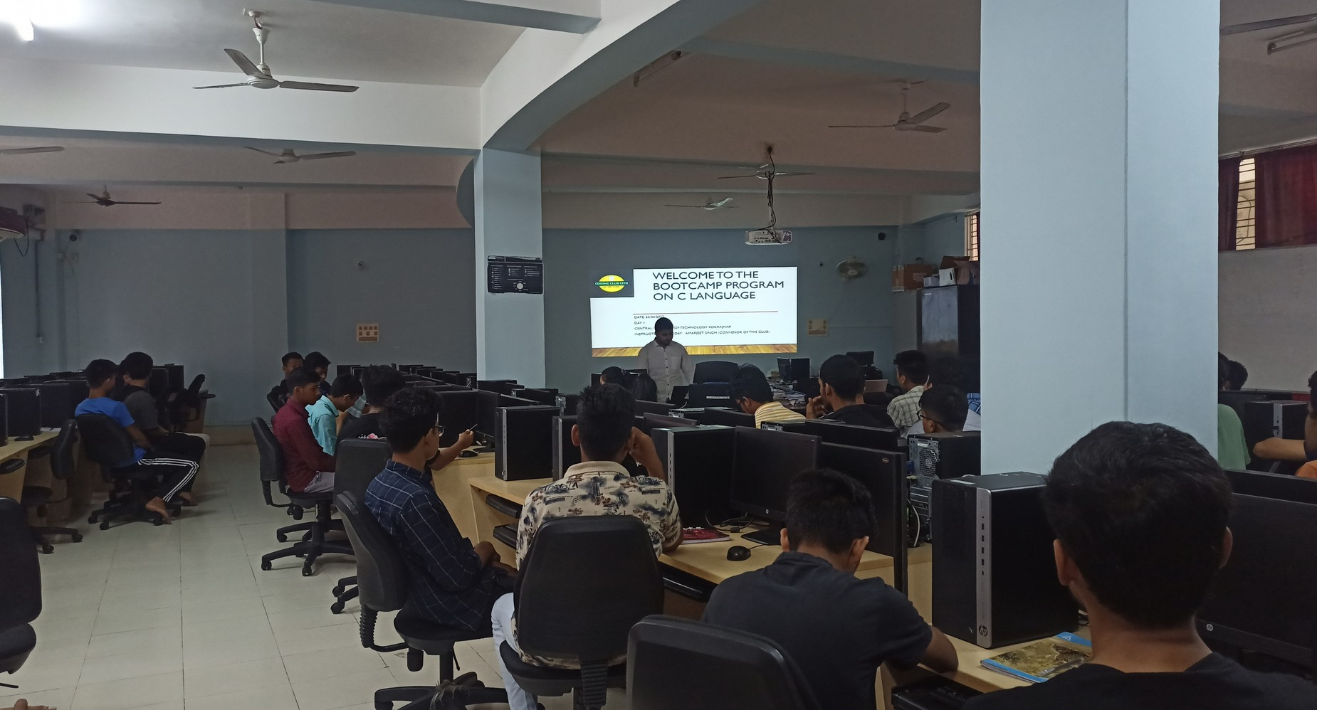
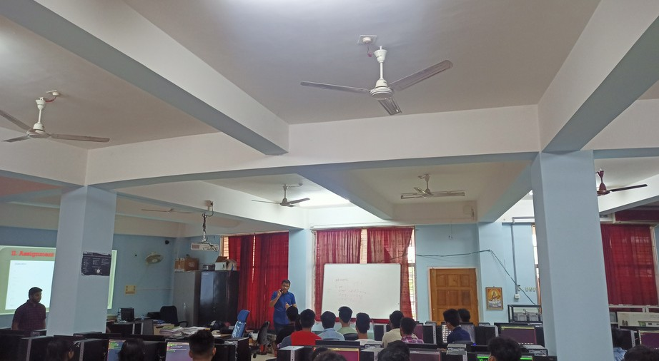
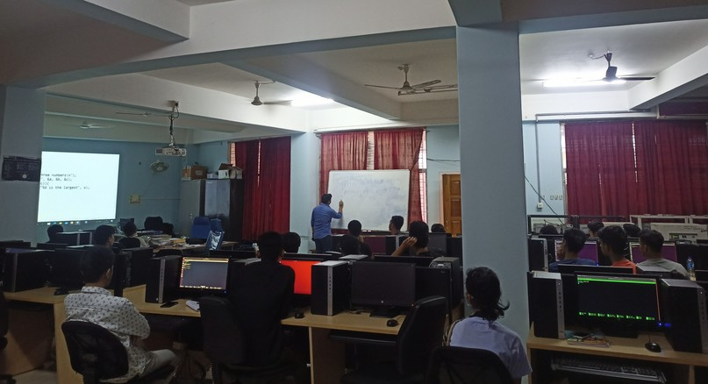
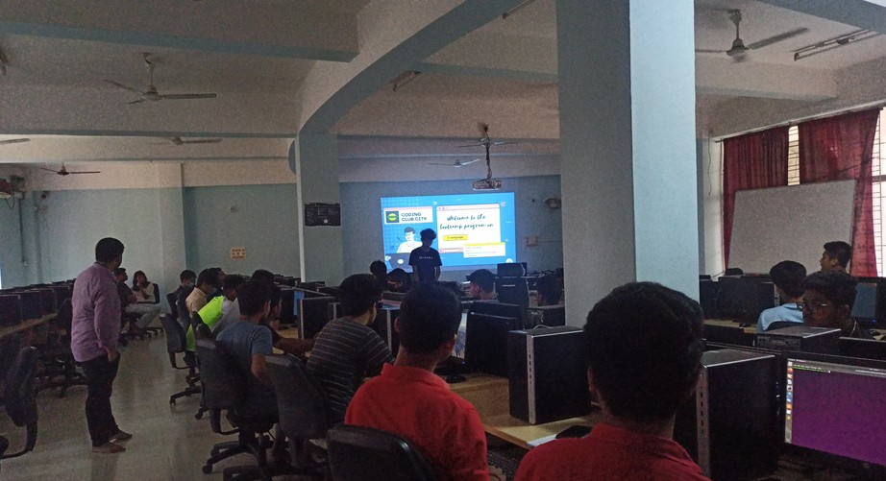
Few glimpses of the Bootcamp on C Programming
Add a subheag

Slide 17
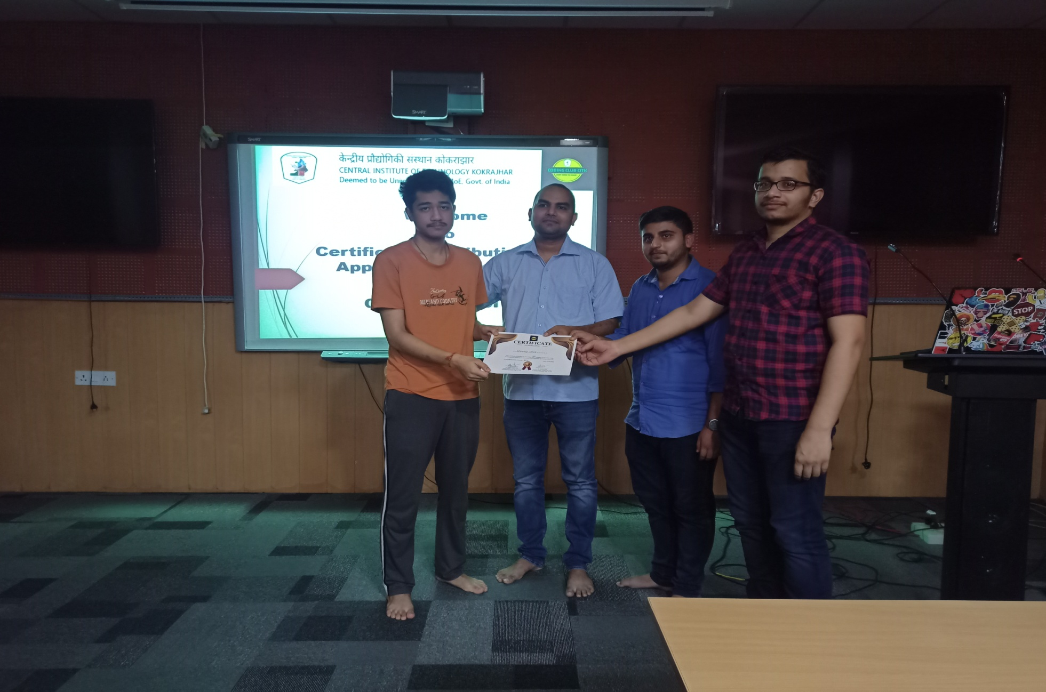
Prize Distribution of the bootcamp:-

Slide 18
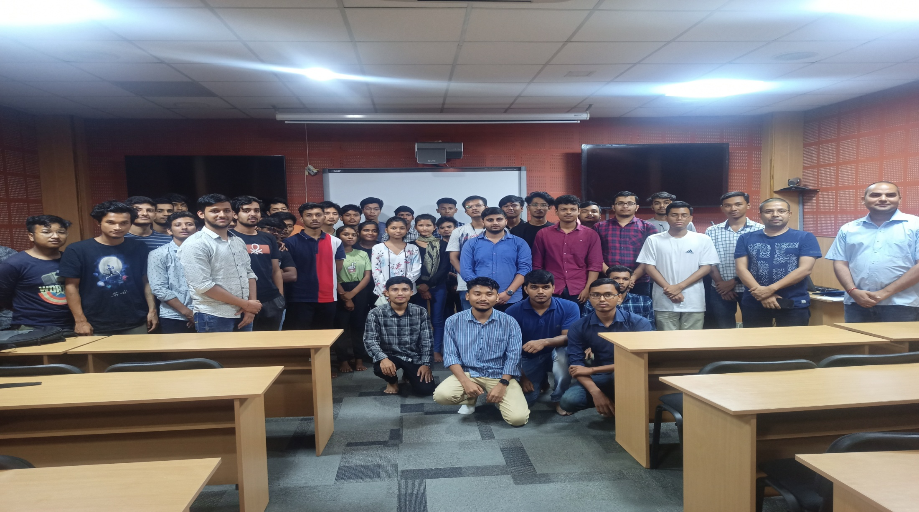
Prize Distribution of the bootcamp:-

Slide 19
Contact details:-
Contact Number:- 9065389731, 7577976991
Email Id:- codingclub@cit.ac.in
Website:- http://technicalclubs.cit.ac.in/coding.html

Slide 20

Thank You

